Slide 1


PALESTINE ISRAEIL CONFLICT
THROUGHOUT THE LENS OF DATA.
Business Intelligent project
Data Science Master
2023-2024
Notes:
Inside the Cpmlexity of history, geopolitics, and humanity, one enduring narrative emerges — the ongoing Palestine-Israel conflict. Today, we embark on a journey to unravel the layers of this intricate story, exploring the role of data and insights in understanding and addressing the challenges of this longstanding conflict. Welcome our presentation project, seeking understanding and illumination in the midst of complexity

Slide 2
THIS PROJECT IS MADE AND PRESENTED BY:
PALESTINIE
ISRAEILI CONFLICT THROUGH THE YEARS
LAGHDAF KHAOULA
OURTANANE ALI
UNDER THE SUPERVISION OF:
Mrs. JIHAD ZAHIR
2023-2024

Slide 3
INTRODUCTION TO OUR PROJECT
01
ABOUT THE PROJECT
02
PROJECT EXTRACT TRANSFORM LOAD
03
TABLE OF CONTENTS
PROJECT AUTOMATIZATION STRATEGY
04
PROJECT PREDICTIF MODEL
05
The Questions that our project will be answering.
Discussing The Bus Matrix, the Logical Model and our data sources.
Discussing The Various Transformations done on our data.
Steps we adopted to realize the automatization strategy on our project.
How we used Weka to create our predictif model.
DEMONSTRATION
06
Finally, discovering the tools we used and our Dashboards.

Slide 4

INTRODUCTION TO OUR PROJECT

Slide 5
FATALITIES & PRISONNERS:
PALESTINIEN REFUGEES:
UNVEILING QUESTIONS: OUR APPROACH
ISREAILI COLONIES:
DEMOGRAPHY& IMMIGRATION:
How has the Palestine-Israeli conflict's death toll changed over time? Additionally, what trends exist in Palestinian detainee numbers, and are there distinct periods of notable change?
How has the Palestinian refugee population evolved over time, examining the factors influencing fluctuations, and what shifts have occurred in the primary countries of asylum for Palestinian refugees?
What is the historical development of Israeli colonies, and how does the population of Israeli settlements evolved over time?
How has the demographic makeup of the Israeli population evolved over time? and what role do immigration patterns play in shaping these changes, particularly identifying periods of noteworthy immigration?

Slide 6

ABOUT THE PROJECT

Slide 7
BUS MATRIX
Fact/ Dimension | Time | MasterTime | Gender | Category | Country | Asylum | ColnieDIM | DemoDIM
Fatalities | X |  | X | X | X
Prisonners |  | X
Colonies |  | X |  |  |  |  | X
Refugees |  | X |  |  |  | X
Demography |  | X |  |  |  |  |  | X
Immigration |  | X
Notes:
Starting about our bus matrix, so as you see we have 6 fact tables and 8 dimension table

Slide 8
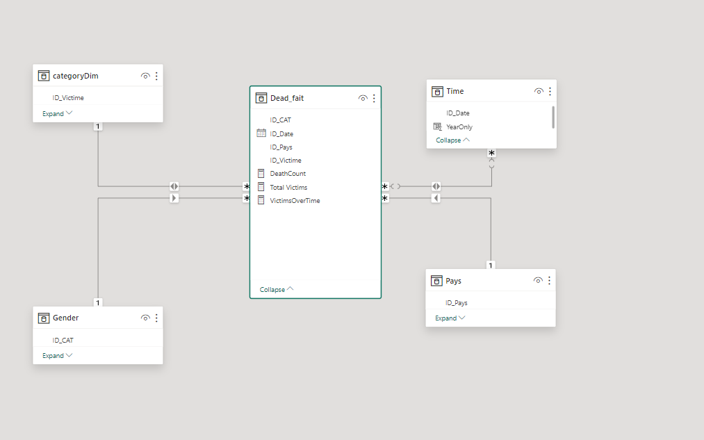
LOGICAL MODEL:
OUR DATA MODEL HAS TWO DATAMARTS, THE FOLLOWING IS THE FIRST DATAMART.
Notes:
For our logical model, we have 2 datamarts, as I montionned before we have 2 time tables dimensions, because when we started searching or collecting data we found that some data started from 2000 with dimension hierarchy of day/month/year when some other data start before 2000, to be exact it starts from 1950 and it has only the year as dimension hierarchy, so we faced a problem that lead us to split out logical model to 2 datamartsFor our first datamart, as you see in the center we have fact table sourended by some dimension tables that connected through foreign keys, and the rest of culumns: deathCount, TotalVictims:, VictimsOverTime => Are some measures that we created like, these gives us informations with specific combination of date, category, country

Slide 9
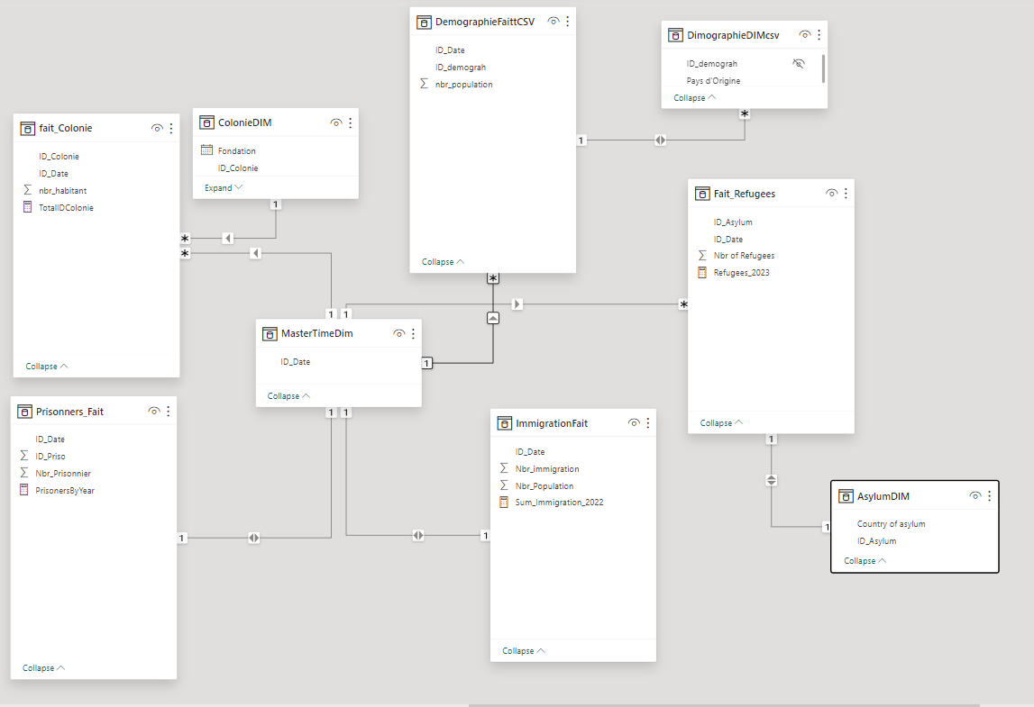
LOGICAL MODEL:
PRESENTING OUR SECOND DATAMART.

Slide 10
OUR DATA SOURCES
FILE TITLE | SOURCE | HYPERLINK | UPDATE FREQUENCY | ACQUISITION METHOD
Palestiniens killed by Israeli forces | Btselem | https://shorturl.at/iCHMW | Every 3 months | Scrapping
Palestinians killed by Israeli civilians | Btselem | https://shorturl.at/iCHMW | Every 3 months | Download
Israeli civilians killed by Palestinians | Btselem | https://shorturl.at/iCHMW | Every 3 months | Download
Israeli forces killed by Palestinians | Btselem | https://shorturl.at/iCHMW | Every 3 months | Download
Refugees | UNHCR | https://shorturl.at/lvyz4 | Every 6 months | Download
Colonnies | WIKIPEDIA | https://shorturl.at/lMRU7 | Every 2-3 months | Copy/Paste
Demography | WIKIPEDIA | https://shorturl.at/dGQS4 | Every 3 months | Copy/Paste
Immigration | PRESPECTVE MONDE | https://shorturl.at/dfiWX | Every year | Scrapping
Population | PRESPECTVE MONDE | https://shorturl.at/ehJY0 | Every year | Copy/Paste
Notes:
We got the data we used in this project from diverse sources, For 4 listed lines, We retrieved them from Btselem( bitiselem), they update the data every 3 monthsFor refugees we got it from the well knowen website unhcr (yow in h c r) and their update of freq is 6 monthsfor colonies and demography we got them from Wikipedia and the data can change every 2 to 3 monthsLast thing prespective monde give us data for immigration and population and they update the data every 6 months“For links those are real links I just made them shorter so they can fit there”We acquire data in different ways like downloading from btselem, and copy paste tables from Wikipedia and lastly we used webscraping from perspective monde

Slide 11


EXTRACT TRANSFORM LOAD

Slide 12
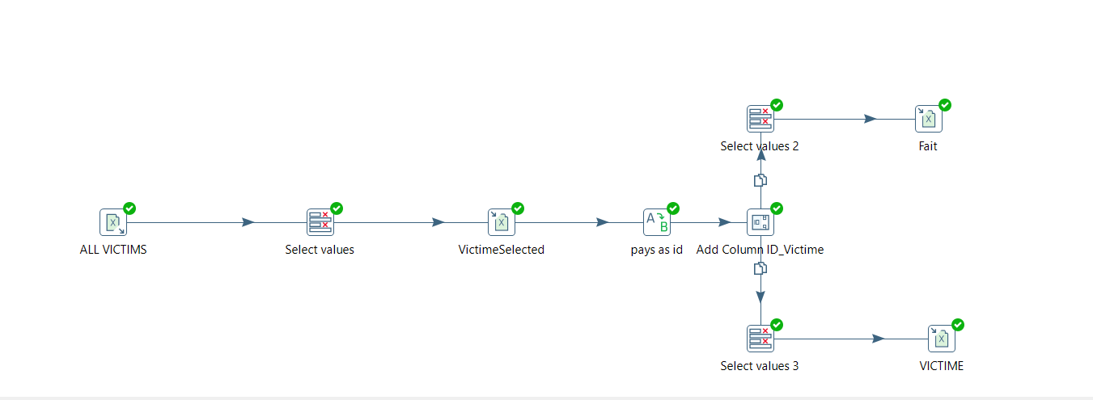
FATALITIES TRANSFORMATION:
OUR FIRST TRANSFORMATIONS WAS CONCERNING THE FATALITIES DATA, IN WHICH THE RESULTED OUTPUT WAS FACT/DIMENSION TABLES.

Slide 13
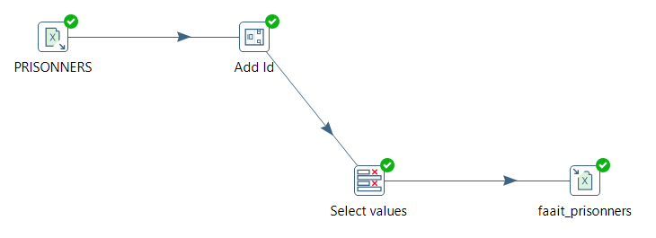
PRISONNERS TRANSFORMATION:
MOVING ON, OUR NEXT TRANSFORMATION WAS ON PRISONNERS DATA WHERE WE EXTRACTED A FACT TABLE.

Slide 14
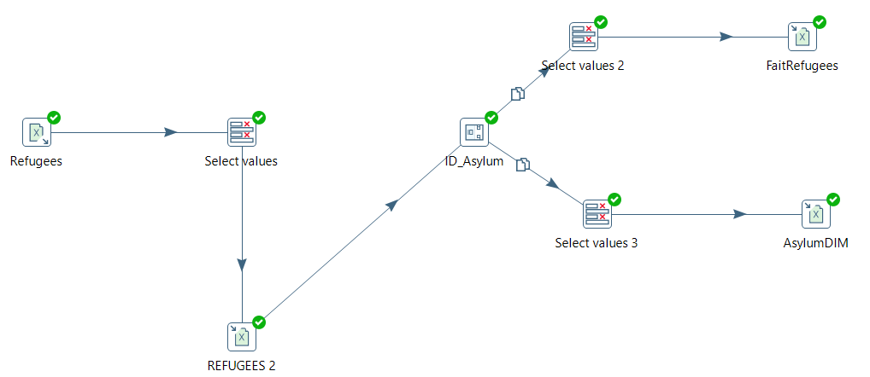
REFUGEES TRANSFORMATION:
NEXT, REFUGEES, THE PDI TRANSFORMATION LED FINALLY TO A FACT/ DIMENSION TABLES.

Slide 15
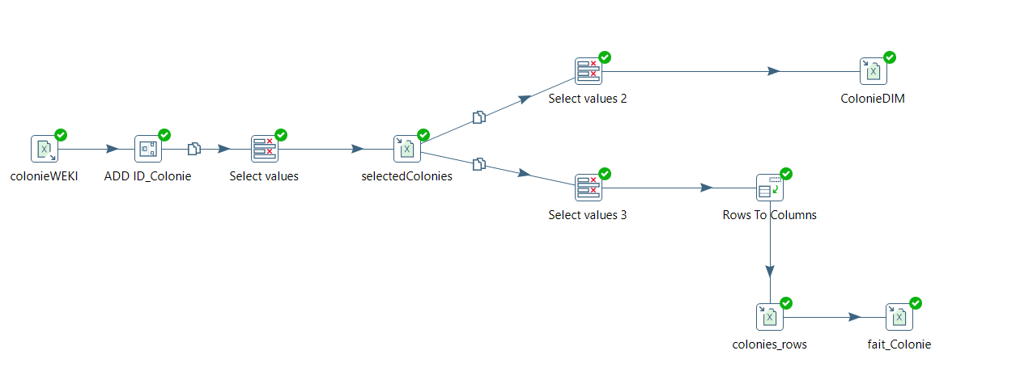
COLONIES TRANSFORMATION:
IN THIS TRANSFORMATION, WE MANAGED, THROUGH THE PDI STEPS TO EXTRACT A FACT / DIMENSION TABLES.

Slide 16
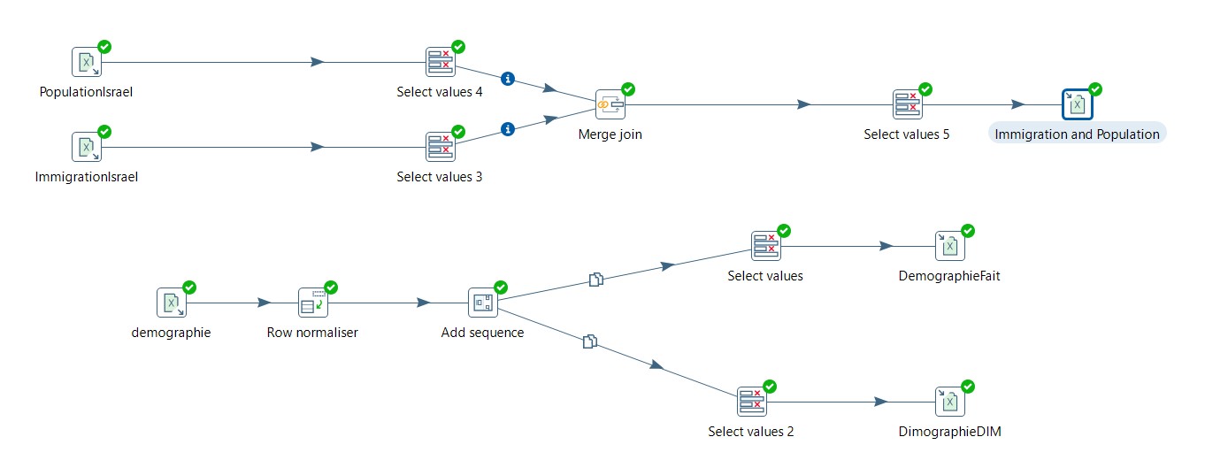
DIMOGRAPHY & IMMIGRATION TRANSFORMATION:
FINALLY, DIMOGRAPHY AND IMMIGRATION TABLES, LET’S GET MORE DETAILES.

Slide 17
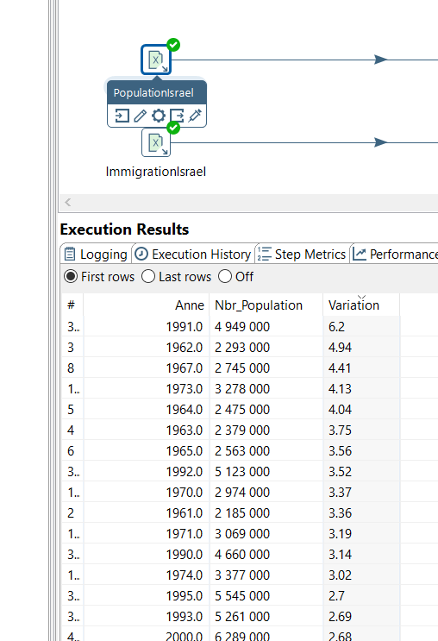
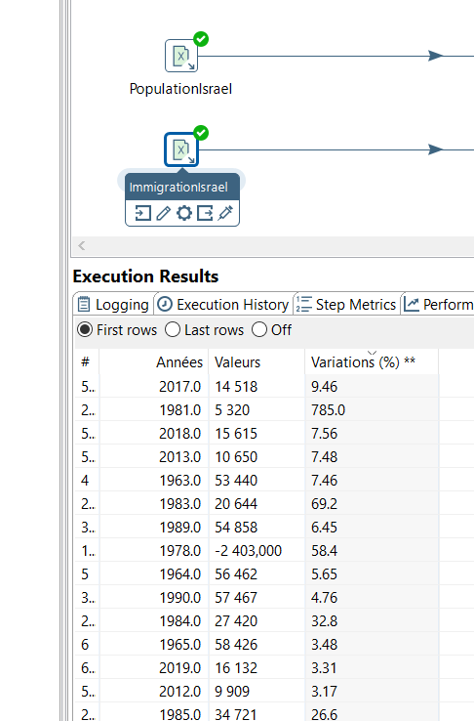
DIMOGRAPHY & IMMIGRATION TRANSFORMATION:
THE INITIAL DATA ON OUR BOTH FILES.

Slide 18
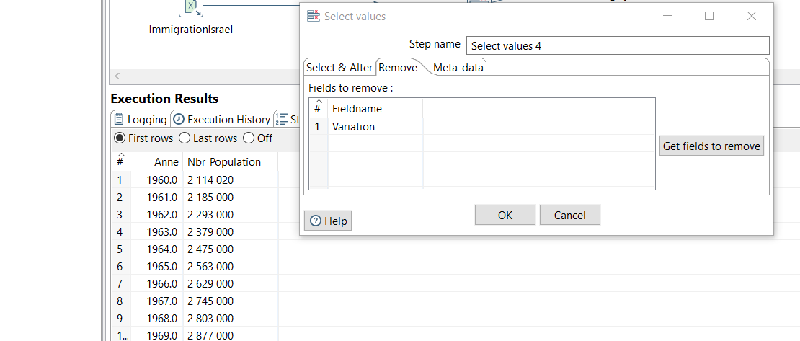
DIMOGRAPHY & IMMIGRATION TRANSFORMATION:
SELECTING THE VALUES WE ARE MOST INTRESTED WITH.

Slide 19
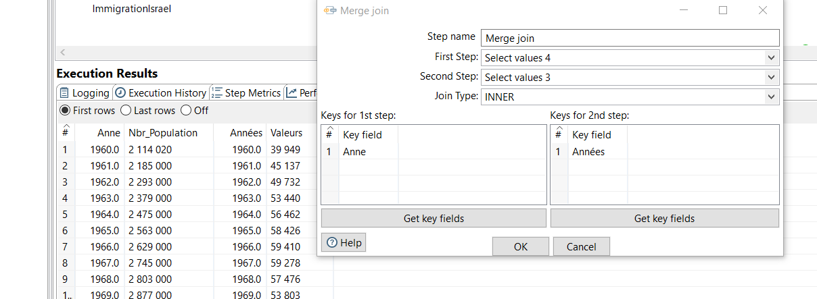
DIMOGRAPHY & IMMIGRATION TRANSFORMATION:
MERGE JOINING THE TWO TABLES.

Slide 20
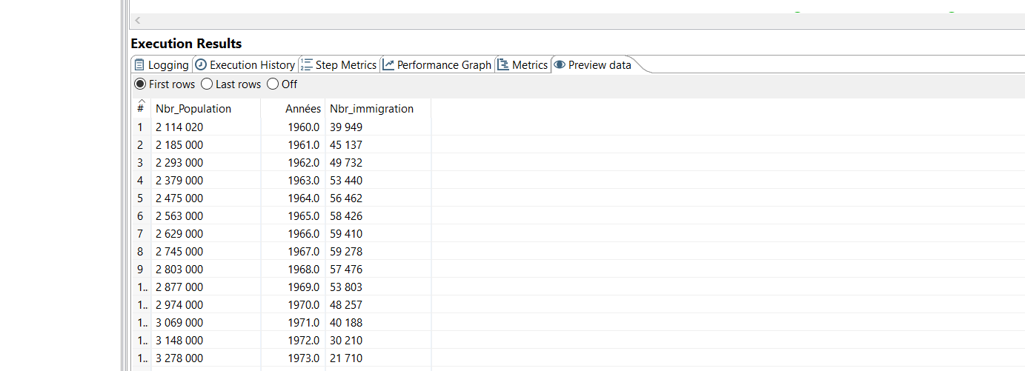
DIMOGRAPHY & IMMIGRATION TRANSFORMATION:
THE OUTPUT IMMIGRANTS TABLE.

Slide 21
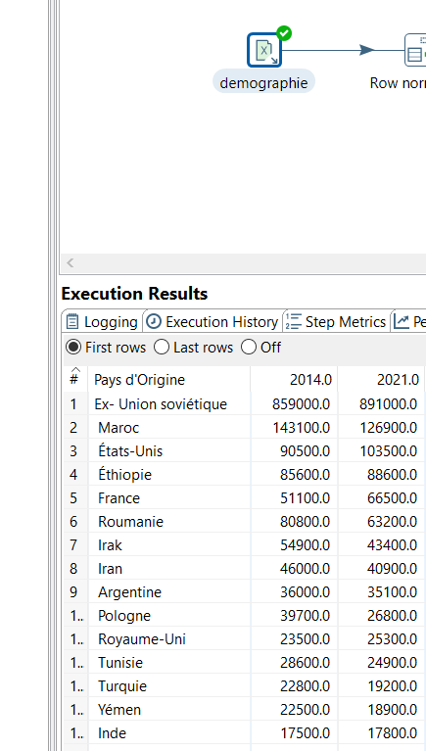
DIMOGRAPHY & IMMIGRATION TRANSFORMATION:
THE INITIAL DIMOGRAPHY TABLE.

Slide 22
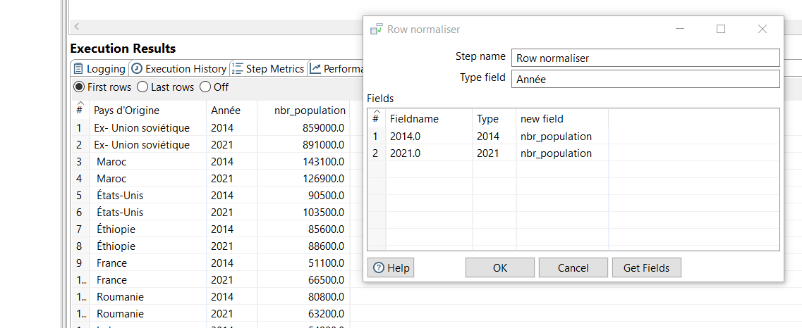
DIMOGRAPHY & IMMIGRATION TRANSFORMATION:
NORMALISING OUR ROWS.

Slide 23
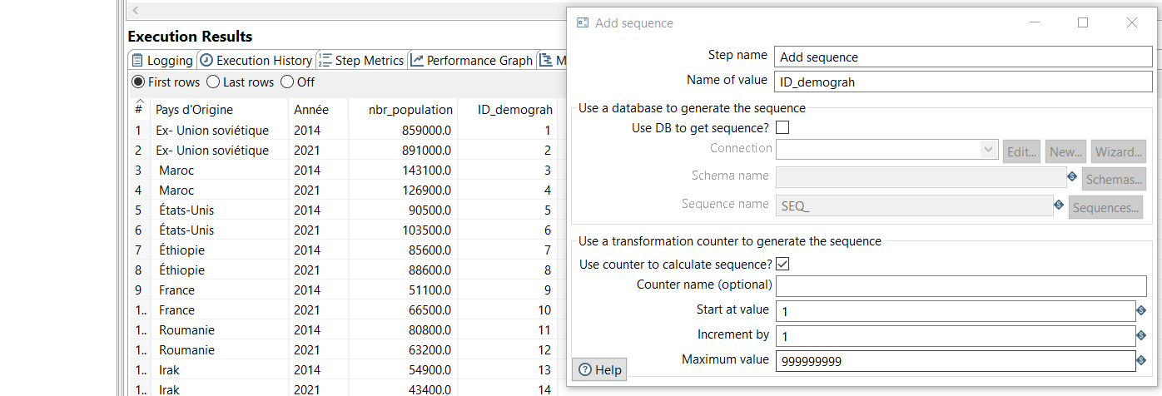
DIMOGRAPHY & IMMIGRATION TRANSFORMATION:
ADDING A COLUMN ID.

Slide 24
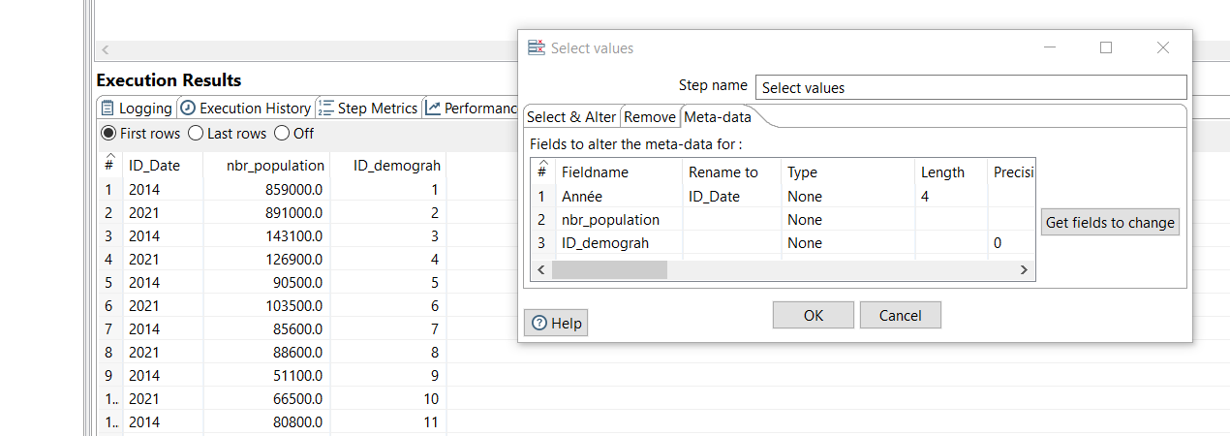
DIMOGRAPHY & IMMIGRATION TRANSFORMATION:
SELECTING OUR FACT TABLE VALUES.

Slide 25
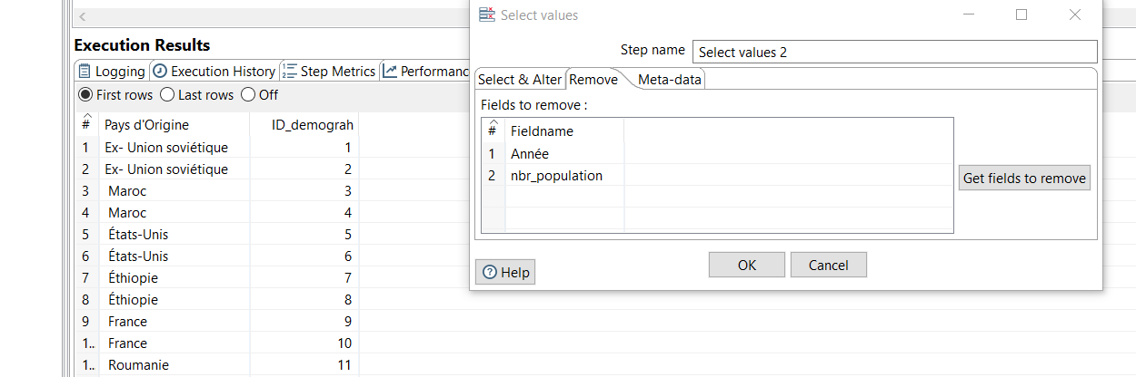
DIMOGRAPHY & IMMIGRATION TRANSFORMATION:
SELECTING OUR DIMENSION TABLE VALUES.

Slide 26

OUR AUTOMATIZATION STRATEGY

Slide 27
DATA SCRAPPING
1
TASK SCHEDULUER
OUR STRATEGY’S STEPS:
PDI JOB
2
3

Slide 28
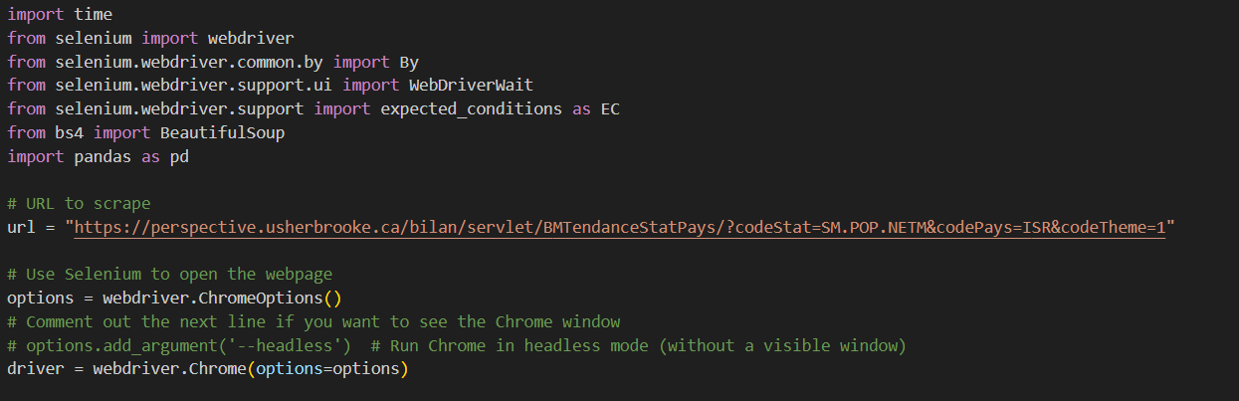
OUR STRATEGY’S STEPS:
DATA SCRAPPING
1
This scraping code utilizes the Selenium and BeautifulSoup libraries in Python to extract tabular data from Perspective Monde Website, which contains information on net migration statistics for Israel.
Notes:
The script opens a Chrome browser using Selenium, navigates to the provided URL, and waits for the table with the ID 'donnees' to be present on the page. Once the table is located, the HTML content is parsed using BeautifulSoup. The script then converts the HTML table into a pandas DataFrame, cleaning it by removing rows with all NaN values. Finally, the cleaned DataFrame is saved to an Excel file named "immigration_israeil.xlsx" at the specified file path. The output provides a structured and organized representation of the migration data, facilitating further analysis and data manipulation.

Slide 29
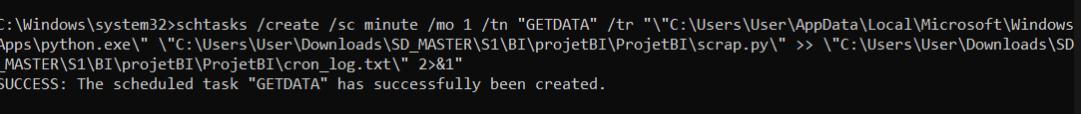

OUR STRATEGY’S STEPS:
TASK SCHEDULUER
2
The Task Scheduler, serving as the orchestrator, ensured that the scraping file ran at specified intervals without requiring manual initiation.
Notes:
The script opens a Chrome browser using Selenium, navigates to the provided URL, and waits for the table with the ID 'donnees' to be present on the page. Once the table is located, the HTML content is parsed using BeautifulSoup. The script then converts the HTML table into a pandas DataFrame, cleaning it by removing rows with all NaN values. Finally, the cleaned DataFrame is saved to an Excel file named "immigration_israeil.xlsx" at the specified file path. The output provides a structured and organized representation of the migration data, facilitating further analysis and data manipulation.

Slide 30
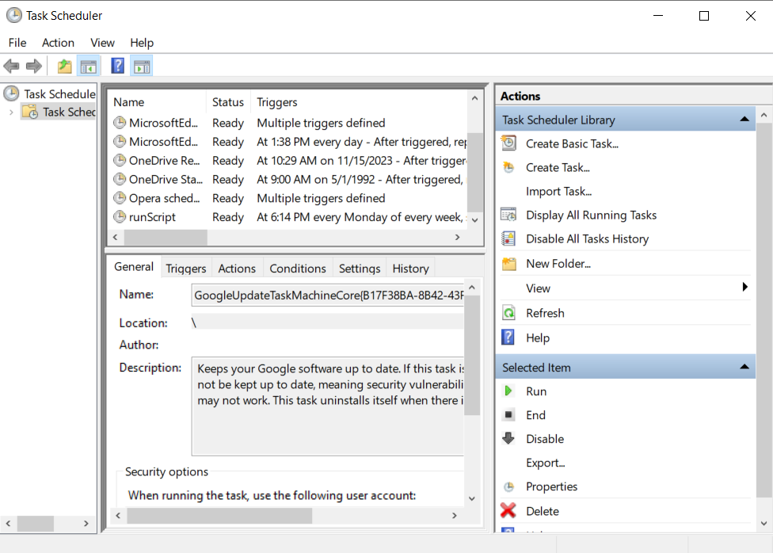
OUR STRATEGY’S STEPS:
TASK SCHEDULUER
2
TASK SCHEDULAR INTERFACE
Notes:
The script opens a Chrome browser using Selenium, navigates to the provided URL, and waits for the table with the ID 'donnees' to be present on the page. Once the table is located, the HTML content is parsed using BeautifulSoup. The script then converts the HTML table into a pandas DataFrame, cleaning it by removing rows with all NaN values. Finally, the cleaned DataFrame is saved to an Excel file named "immigration_israeil.xlsx" at the specified file path. The output provides a structured and organized representation of the migration data, facilitating further analysis and data manipulation.

Slide 31
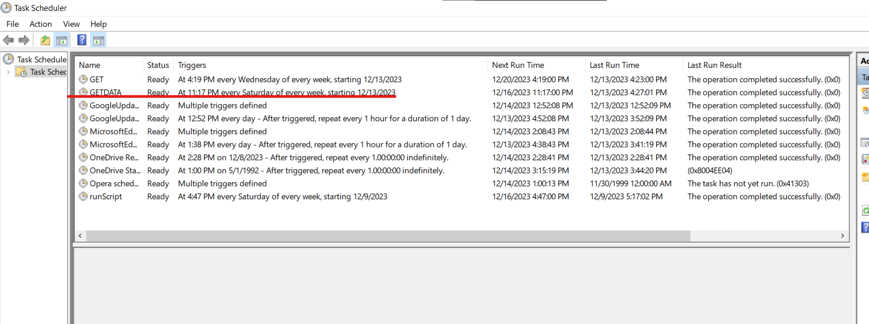
OUR STRATEGY’S STEPS:
TASK SCHEDULUER
2
THE TASK WE CREATED IS SUCSSESFULY ADDED TO TASK SCHEDULAR
Notes:
The script opens a Chrome browser using Selenium, navigates to the provided URL, and waits for the table with the ID 'donnees' to be present on the page. Once the table is located, the HTML content is parsed using BeautifulSoup. The script then converts the HTML table into a pandas DataFrame, cleaning it by removing rows with all NaN values. Finally, the cleaned DataFrame is saved to an Excel file named "immigration_israeil.xlsx" at the specified file path. The output provides a structured and organized representation of the migration data, facilitating further analysis and data manipulation.

Slide 32
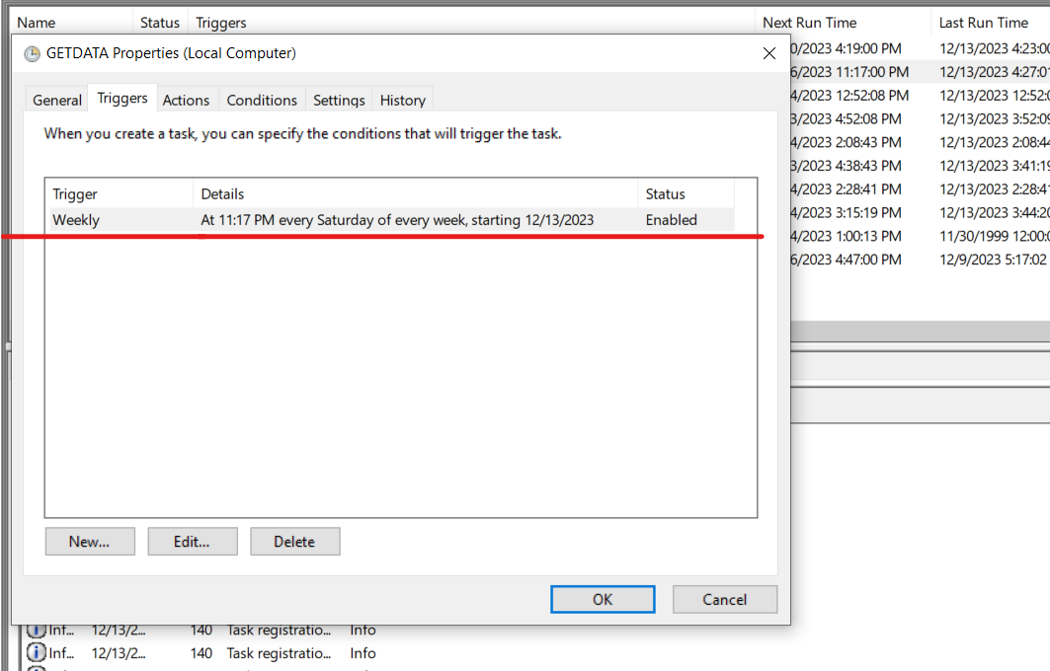
OUR STRATEGY’S STEPS:
TASK SCHEDULUER
2
CONFIGURATION OF OUR TASK SCHEDULAR
Notes:
The script opens a Chrome browser using Selenium, navigates to the provided URL, and waits for the table with the ID 'donnees' to be present on the page. Once the table is located, the HTML content is parsed using BeautifulSoup. The script then converts the HTML table into a pandas DataFrame, cleaning it by removing rows with all NaN values. Finally, the cleaned DataFrame is saved to an Excel file named "immigration_israeil.xlsx" at the specified file path. The output provides a structured and organized representation of the migration data, facilitating further analysis and data manipulation.

Slide 33
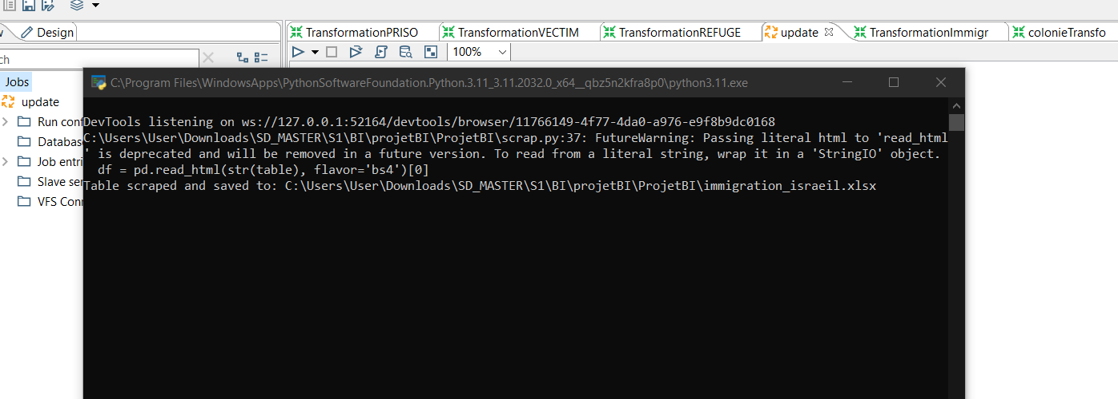
OUR STRATEGY’S STEPS:
TASK SCHEDULUER
2
RESULTS OF RUNNING THE SCRIPT IN TASK SCHEDULAR
Notes:
The script opens a Chrome browser using Selenium, navigates to the provided URL, and waits for the table with the ID 'donnees' to be present on the page. Once the table is located, the HTML content is parsed using BeautifulSoup. The script then converts the HTML table into a pandas DataFrame, cleaning it by removing rows with all NaN values. Finally, the cleaned DataFrame is saved to an Excel file named "immigration_israeil.xlsx" at the specified file path. The output provides a structured and organized representation of the migration data, facilitating further analysis and data manipulation.

Slide 34
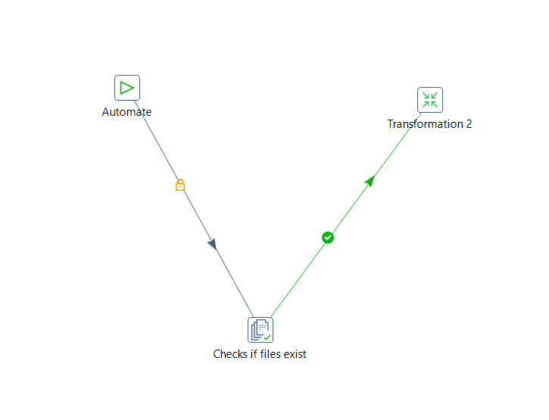
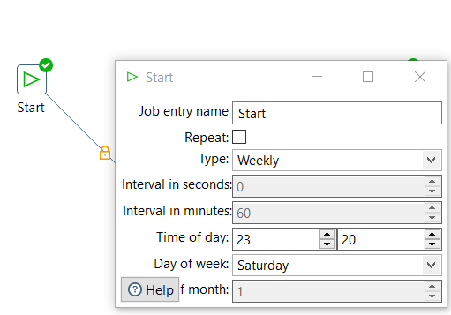
OUR STRATEGY’S STEPS:
PDI JOB
3
CREATING AND CONFIGURING OUR PDI JOB
Notes:
The script opens a Chrome browser using Selenium, navigates to the provided URL, and waits for the table with the ID 'donnees' to be present on the page. Once the table is located, the HTML content is parsed using BeautifulSoup. The script then converts the HTML table into a pandas DataFrame, cleaning it by removing rows with all NaN values. Finally, the cleaned DataFrame is saved to an Excel file named "immigration_israeil.xlsx" at the specified file path. The output provides a structured and organized representation of the migration data, facilitating further analysis and data manipulation.

Slide 35
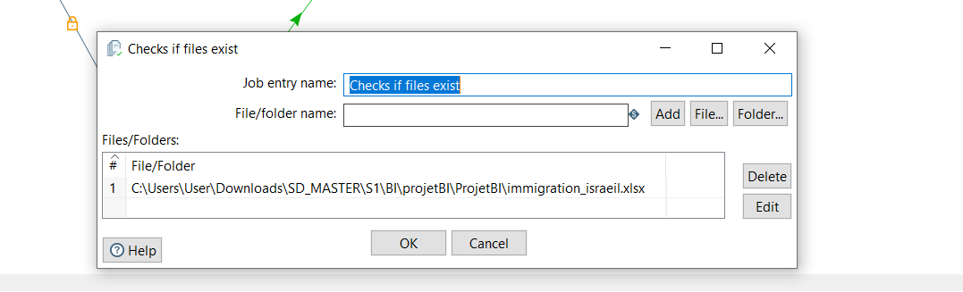
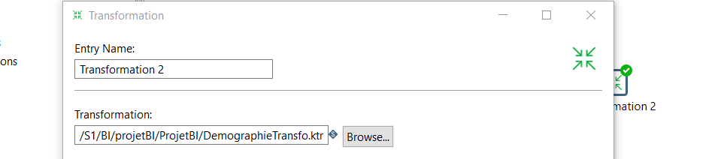
OUR STRATEGY’S STEPS:
PDI JOB
3
GIVING THE PATH TO THE FILE AND THE TRANSFORMATION
Notes:
The script opens a Chrome browser using Selenium, navigates to the provided URL, and waits for the table with the ID 'donnees' to be present on the page. Once the table is located, the HTML content is parsed using BeautifulSoup. The script then converts the HTML table into a pandas DataFrame, cleaning it by removing rows with all NaN values. Finally, the cleaned DataFrame is saved to an Excel file named "immigration_israeil.xlsx" at the specified file path. The output provides a structured and organized representation of the migration data, facilitating further analysis and data manipulation.

Slide 36
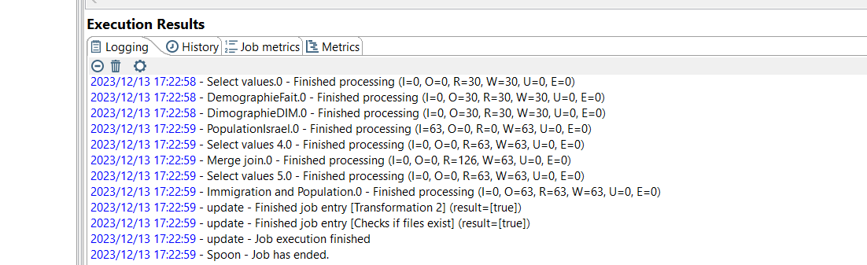
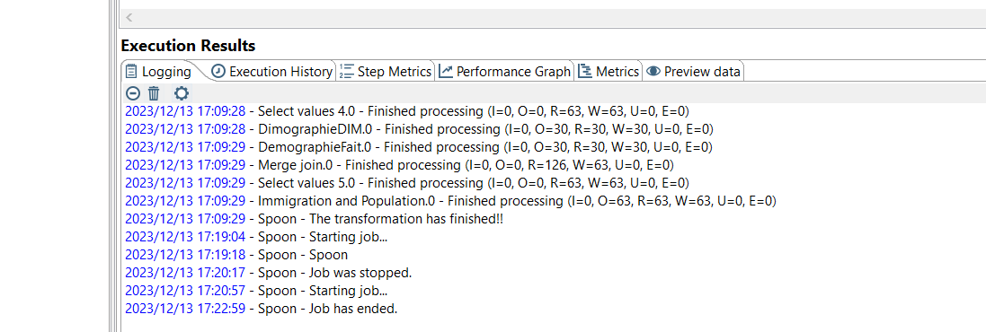
OUR STRATEGY’S STEPS:
PDI JOB
3
RESULTS OF RUNNING OUR PDI JOB
Notes:
The script opens a Chrome browser using Selenium, navigates to the provided URL, and waits for the table with the ID 'donnees' to be present on the page. Once the table is located, the HTML content is parsed using BeautifulSoup. The script then converts the HTML table into a pandas DataFrame, cleaning it by removing rows with all NaN values. Finally, the cleaned DataFrame is saved to an Excel file named "immigration_israeil.xlsx" at the specified file path. The output provides a structured and organized representation of the migration data, facilitating further analysis and data manipulation.

Slide 37

OUR PREDICTIF MODEL
You can replace the image on the screen with your own

Slide 38
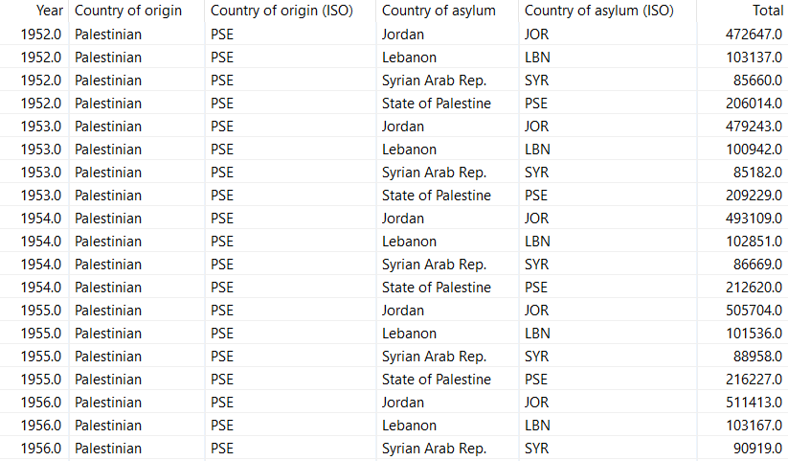
OUR DATA
RESULTS OF RUNNING THE SCRIPT IN TASK SCHEDULAR
Notes:
Now we arrived to predict part, we used weka to achieve this, so we took the data of number of Palestinian refugees where we are going to apply the prediction, as you see the data contains the year, country,,,,,,,Let’s devide this part to steps => we already analyse the data and our object is to predict the total number of refugeeswe load our data, for us it was csv so we made it arff extention to deal with it And we choosed our model ( choice )

Slide 39
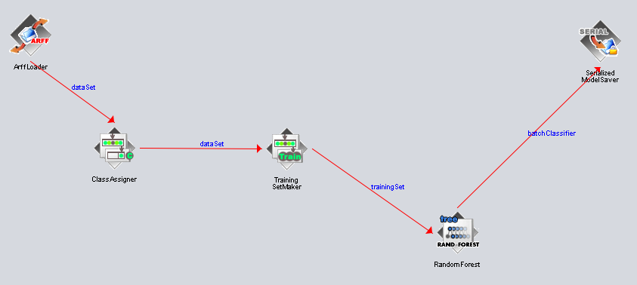
WEKA MODEL
WE USED RANDOM FOREST MODEL IN WEKA.
Notes:
Random Forest is a supervised learning algorithm that uses a group of decision trees, each trained on a different subset of the dataThe final prediction is made by combining the outputs of these trees. ArffLoader: reads the ARFF file and converts it into a format that WEKA can understand.ClassAssigner: designates which attribute is the class, this is crucial for supervised learning where the algorithm learns from labeled examplesTrainingSetMaker: It takes the dataset and separates it into two sets - one used to teach (train) the model and the other to check how well the model is doingRandomForest: It creates a "forest" (collection) of decision trees, each tree is trained on a different subset of the data and votes on predictions. SerializedModelSaver: This component is used to save the trained Random Forest model after it has been trained, so we can reuse it later without having to retrain it ( Pentaho)

Slide 40
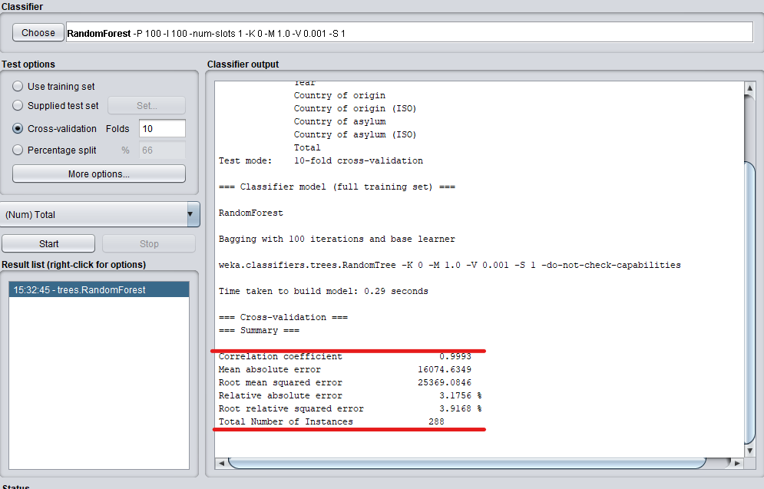
WEKA MODEL
OUR MODEL METRICS
Notes:
correlation coefficient : close to 1 suggests a very strong positive correlation between the predicted values and the actual outcomes. In this case, the model is capturing the patterns in the data extremely well.
Mean Absolute Error (MAE): measures the average size of errors between predicted and actual values. A lower MAE indicates better accuracy, and in this case, the value is relatively low.Root
Mean Squared Error (RMSE): represents the standard deviation of the residuals, a lower RMSE suggests better model performance. Relative Absolute Error: A lower percentage suggests better accuracy.
Root Relative Squared Error: Similar to relative absolute error, again, a lower percentage is desirable.

Slide 41
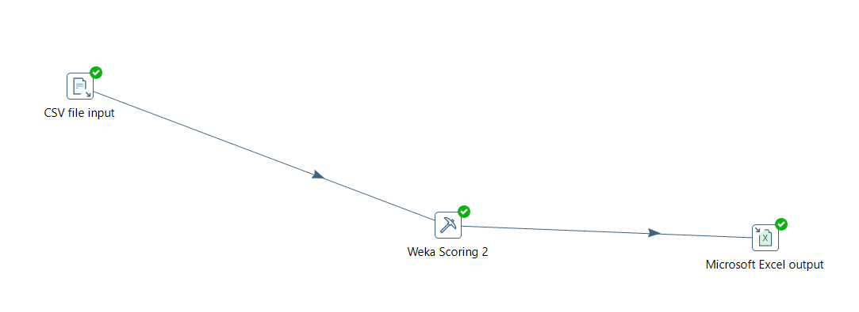
WEKA MODEL
PDI TRANSFORMATION
Notes:
Here we include our model in Pentaho using some tools available there, so we have our data then weka scoring where we select our model then we will have our output of data that predict number of refugees

Slide 42
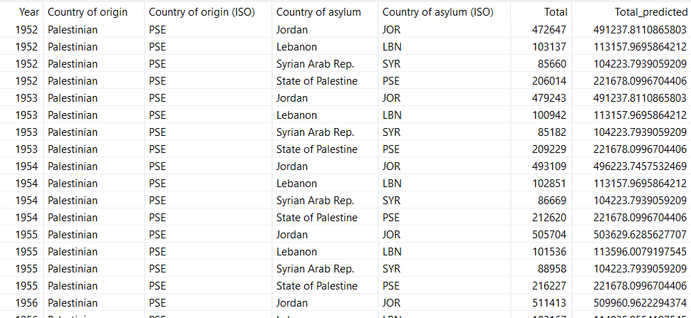
WEKA MODEL
PDI TRANSFORMATION FINAL RESULTS
Notes:
and like you see the total protected giving and that’s incredible close to what we have

Slide 43





THE TOOLS WE USED:
EXCEL
PENTAHO
POWER BI
Organized and presented the raw data for better understanding and visualization.
Transformed and cleaned the raw data using Pentaho PDI to make it suitable for analysis.
Visualized the transformed data using Power BI to create interactive and insightful reports and dashboards.
PYTHON
WEKA
TASK SCHEDULER
Created a Python script to automate the process of updating data, using Selenium and beautiful soup libraries.
Applying the RandomForest algorithm to build a predictive model
Automated the execution of the Python script and PDI job at specified intervals, ensuring timely updates to the data..
Notes:
Tools that we used durant this work,

Slide 44

DEMENSTRATION

Slide 45
THANK YOU FOR YOUR ATTENTION!
Notes:
Tools that we used durant this work,

